Slide 1
Bias-Variance Tradeoff
(Slides modified from those of Prof. Y. Liang, U. Wisconsin)

Slide 2
Error = bias + variance + …
= expectation (over different data sets D) for
2
E _{D} [( f (x; D) − E[y | x]) ]=
2
(E_{D} [ f (x; D)] − E [y | x])
2
+ E_{D} [( f (x; D) − E_{D} [ f (x; D)]) ]
bias
variance
Bias: if on average f (x; D) differs from E [y | x] then f (x; D) is a biased estimator of E [y | x]
Variance: f (x; D) may be sensitive to D and vary a lot from its
expected value

Slide 3
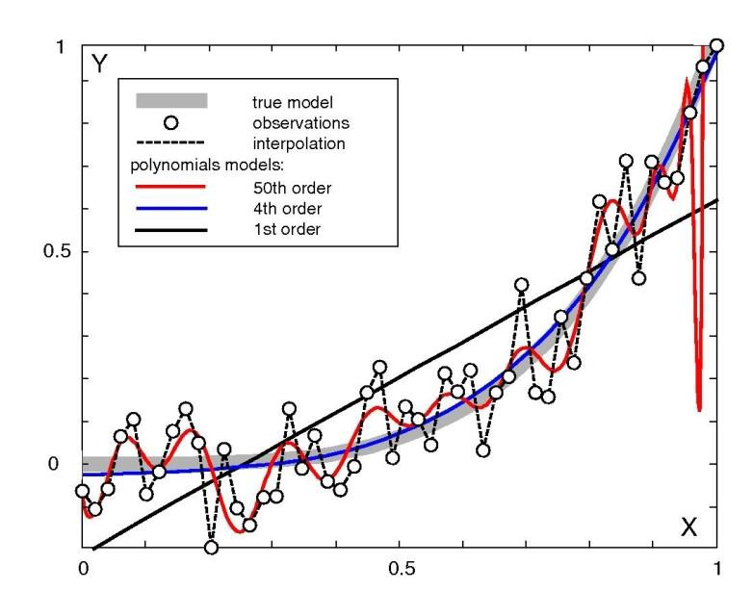
Bias/variance for polynomial interpolation
the 1st order polynomial has high bias, low variance
50th order polynomial has low bias, high variance
4th order polynomial represents a good trade-off

Slide 4
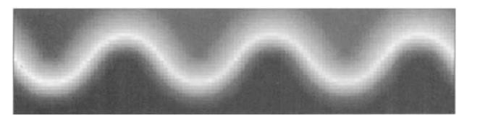
Bias/variance trade-off for k-NN regression
consider using k-NN regression to learn a model of this
surface in a 2-dimensional feature space

Slide 5
Bias/variance trade-off for k-NN regression
bias for 1-NN
darker pixels correspond to higher values
variance for 1-NN
bias for 10-NN
variance for 10-NN

Slide 6
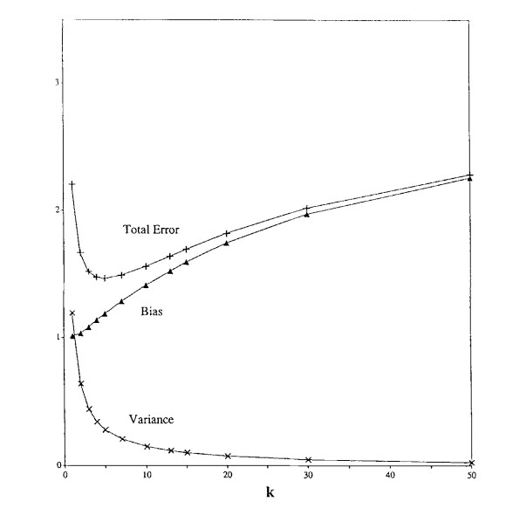
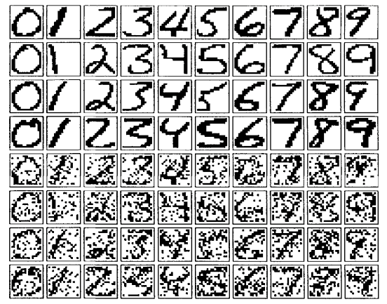
Bias/variance trade-off
consider k-NN applied
to digit recognition

Slide 7
Bias/variance Discussion
Predictive error has two controllable components
expressive/flexible learners reduce bias, but increase
variance
For many learners we can trade-off these two components (e.g. via our selection of k in k-NN)
The optimal point in this trade-off depends on the particular problem domain and training set size
This is not necessarily a strict trade-off; e.g. with ensembles we can often reduce bias and/or variance without increasing the other term

Slide 8
Bias/variance Tradeoff
Helps explain why simple learners can outperform more complex ones
Helps understand and avoid overfitting

